Slide 1
Process
Account Sales Data
Pre-identified single purchase customers
Dataframe containing their prior purchase info
Salesperson/Marketer Interaction
Views their metrics
Input Date for Q2-1997
Action Plan Builder
After inputting dates outputs customer ID’s sorted by their stats - past the 50 day threshold
# of single purchasers
% single purchasers
Latency between 1st/2nd purchase
Intel Confidential

Slide 2
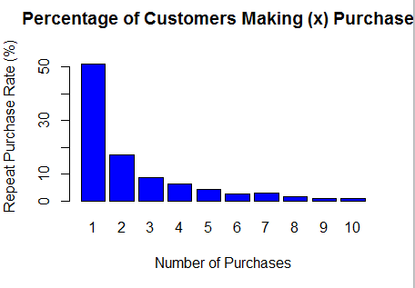
Design
# of single purchasers
% single purchasers
Latency between 1st/2nd purchase
ID | Date | Amount | Interval | Times | TotalTimes
Input Date

